Slide 1
MODULE 4: 5G Security and Privacy
M4 S3
Privacy-Preserving Techniques in 5G
Threat Detection and Mitigation in 5G Networks

Slide 2
Privacy-Preserving Techniques in 5G
A critical challenge for the government and enterprises is ensuring data security and privacy when processing huge datasets.
Most IT companies collect, transport, store, and analyze large datasets and face significant privacy issues every day.
These issues make the realization of the “Society 5.0” project a challenging issue.
The issues of data protection during transmission and at rest have attracted scholarly attention recently.
Cryptographic-based security mechanisms propose different solutions to safeguard the security of datasets as they transit across networks or are stored in data warehouses, for example, encryption and blockchain technologies.
However, the unresolved issue is how to preserve the privacy of the collected data effectively and securely while it is being processed.

Slide 3
Privacy-Preserving Techniques in 5G
Security and privacy in wearable sensors in the era of 5G [AR-e.g.]
Augmented reality technologies are rapidly developing and becoming commercially available. These innovative mechanisms provide new security and privacy concerns and objections.
These difficulties can be divided into two categories: extent and application of the system.
Overlaps among applications sharing different types of devices and more complicated authentication protocols for wearable sensors provide security and privacy problems with AR technology.
Although some problems may be solved by adapting current solutions to smartphones, others require innovative methods for wearable devices.

Slide 4
Privacy-Preserving Techniques in 5G
Security and privacy in wearable sensors in the era of 5G [AR-e.g.]
First, a sophisticated collection of information is always in most of the devices and sensors (e.g., GPS and microphones).
Second, most innovative wearable sensors have multiple interactive outputs, such as touchscreens and voice commands.
Majority of the device platforms can run several applications simultaneously and can connect wirelessly with other augmented reality devices.
This gives companies an alternative approach to deploying collaboration platforms to enhance the performance of virtual reality and augmented reality applications.
The joint effort could produce new innovative ideas, especially with on-device AI-enabled technology.

Slide 5
Privacy-Preserving Techniques in 5G
Security and privacy in wearable sensors in the era of 5G [AR-e.g.]
Augmented reality applications may require access to various sensor data to work properly, such as video and audio feeds and GPS data.
A major issue of AR systems (such as desktop and smartphone operating systems) is to balance the access necessary for functioning with the danger of an application stealing data or misusing that access.
For example, a rogue program may leak a user's location or video stream to its backend servers.
Moreover, VR/AR systems have the capability to record significantly more personally identifiable information than conventional systems.
Thus, VR/AR systems can have a significant influence on user privacy, such as eye-tracking technology, collecting biometric data, recording microphones, capturing images, location-tracking, etc.

Slide 6
Privacy-Preserving Techniques in 5G
Security and privacy in wearable sensors in the era of 5G [AR-e.g.]
Augmented reality applications use computer-generated graphics to overlay improvements on the user’s perspective of reality using big data and machine learning techniques, especially with virtual reality industrial applications.
These applications quickly develop and become more commercially available, especially considering the expansion of wearable device exploitation.
The collected data from wearable devices help further AR applications to enhance the reality for users.
However, these developments have resulted in high concerns of privacy and security challenges.
For example, regarding health monitoring wearable devices, we can observe some techniques for healthcare monitoring based on the wearable sensors for visual reality and mobile AR

Slide 7
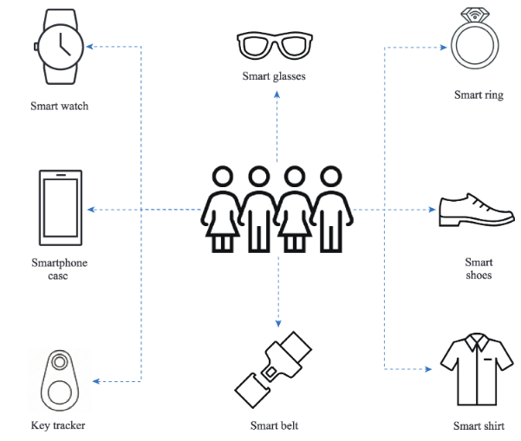
Privacy-Preserving Techniques in 5G
Security and privacy in wearable sensors in the era of 5G [AR-e.g.]
Figure shows some examples of wearable devices that can be used for AR and VR applications.
There are other security aspects for wearable healthcare sensors.
This may cause some problems by manipulating the physical hardware or some problems when the device is measuring data from several sensors and preserving the privacy for predictive analysis.

Slide 8
Privacy-Preserving Techniques in 5G
Framework Of The Privacy-preserving Technique
Our main goal is to assess state-of-the-art solutions for the statistical analysis of confidential data and minimize concerns of the user's privacy.
These techniques should enable the use of advanced analytic techniques over encrypted private information sets with very large and diverse big datasets.
They can also have the capacity to delegate computations to a third party, such as cloud providers, considering the resources.
In addition, the competency of data analysts has spurred advancements toward efficient privacy-preserving deep learning for big data analysis.
Therefore, several techniques have been developed to assess the usability, level of security, and performance of homomorphic encryption when used in big data applications.

Slide 9
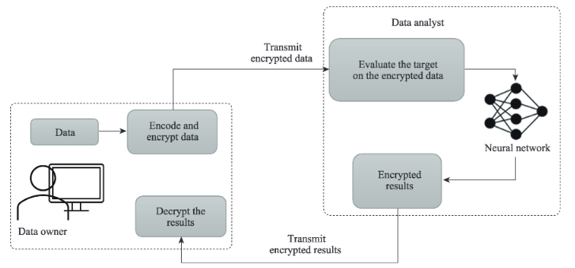
Privacy-Preserving Techniques in 5G Framework Of The Privacy-preserving Technique
The Framework of Privacy-Preserving Encryption is Shown in Figure.

Slide 10
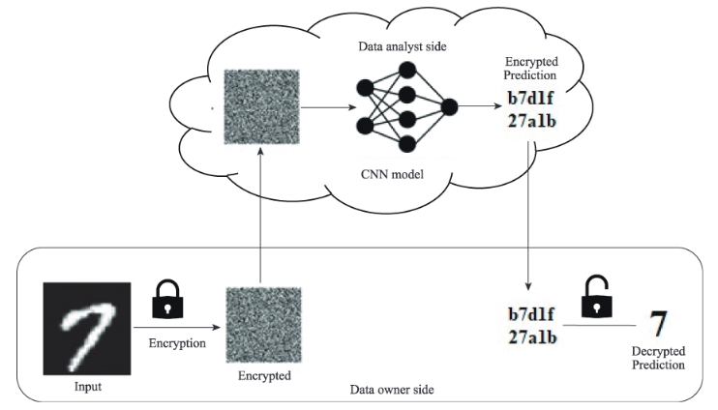
Privacy-Preserving Techniques in 5G Framework Of The Privacy-preserving Technique
The Framework of Advance Privacy-Preserving Encryption is Shown in Figure.

Slide 11
Privacy-Preserving Techniques in 5G Framework Of The Privacy-preserving Technique
Initially, private prediction is introduced as a service when the data owner outsources a third party for analytics or the prediction of private encrypted data.
For example-1, consider an untrustworthy data analyst with a trained model and perhaps the computational capabilities to perform the analytic tasks.
For example-2, consider an untrustworthy data analyst with a trained model and perhaps the computational capabilities to perform the prediction challenge.

Slide 12
Threat Detection and Mitigation in 5G Networks
With communications, computation, and storage capabilities, IoT devices in cyberspace could deeply interact with humans in the physical world.
The features of high transmission rate, low latency, and ubiquitous connectivity make 5G a promising communication bearer to support applications of AIoT (Artificial Intelligence of Things).
For example, an intelligent factory scenario in Non-Public Network (NPN) where AIoT devices with 5G connectivity are deployed in a factory to facilitate the high-precision operations of manufacturing.
Moreover, AIoT integrated into a vehicle enables autonomous driving with the assistance of low latency and reliable 5G communications.
The combination of core technologies of 5G, AI, and IoT, on the one hand, opens the door to innovation but, on the other hand, amplifies the security threats originating from individual components.

Slide 13
Threat Detection and Mitigation in 5G Networks
The challenges of providing security to AIoT (Artificial Intelligence of Things) in 5G networks originate from the following layers
IoT in the service layer.
AI in the data and model layer.
5G in the communication layer.

Slide 14
Threat Detection and Mitigation in 5G Networks
IoT in the service layer.
The cruel competition of IoT products forces vendors to neglect security considerations to shorten release time, resulting in common weaknesses such as hard-coded passwords, unsafe random number processing, dangerous process execution, or dangerous memory operations.
The heterogeneous designs of firmware, protocols, controllers, peripherals, and chips in IoT devices hinder the development of general cybersecurity solutions.
IoT endpoint devices’ constrained resources and inaccessibility make traditional security protections for desktops inapplicable

Slide 15
Threat Detection and Mitigation in 5G Networks
AI in the data and model layer.
By investigating the massive raw data captured from IoT devices using well-trained models, machine learning (ML) helps understand critical information and knowledge to facilitate AIoT application.
Different kinds of ML schemes are built. For example, federated learning is designed for massively distributed training of ML models among AIoT devices without accessing their local training datasets so that privacy is preserved.
Moreover, transfer learning provides AIoT application developers without sufficient resources and effective ML models by transferring the learned knowledge of pre-trained models via fine-tuning.

Slide 16
Threat Detection and Mitigation in 5G Networks
AI in the data and model layer.
Since the accuracy of ML applications is data and model-dependent, adversaries could corrupt the learning model by launching data or model-poisoning attacks to make the model ineffective.
In particular, a backdoor is injected into the trained models in the above two scenarios to mislead the poisoned model to misclassify an input with a particular trigger.

Slide 17
Threat Detection and Mitigation in 5G Networks
5G in the communication layer.
The sophisticated Authentication and Key Agreement (AKA) procedures evolved from each generation of the cellular network provide mutual authentication as well as confidentiality and integrity protection between User Equipment (UE) and Core Network (CN).
The public key protection for signaling messages exchanged before AKA make spoofing or relaying of message much more difficult.
The appearance of cheap Software-Defined Radio (SDR) and 5G open source enables the attack from rogue/fake Base Station (BS), where experimental 5G BS behaving the same as the operational one misleads victim UE to achieve sensitive information stealing or service disabling.

Slide 18
MODULE 4: 5G Security and Privacy
M5 S3
Network Slice Isolation
Virtualized Infrastructure Security
Network Function Verification
Secure Over-the-Air (OTA) Updates

Slide 19
Network Slice Isolation
Network slicing is a revolutionary concept of enabling mobile networks on-demand.
It extends the business model of mobile networking from the traditional tariff subscription to the new cloud computing paradigm: network slice as a service (NSaaS).
The basic principles of network security, are authentication, authorization, confidentiality, integrity, and availability.
The new business model and service opportunities are motivating vertical industries to join and develop their own mobile networks and specify the network infrastructure capabilities and performance to align with their business and application characteristics.

Slide 20
Network Slice Isolation
The new business model and service opportunities are motivating vertical industries to join and develop their own mobile networks and specify the network infrastructure capabilities and performance to align with their business and application characteristics.
To achieve this aim, it requires adequately defining the defense mechanisms that protect all deployed network slices of various types with different network performance and security requirements.
In particular, these defending mechanisms have to be considered not only for the traditional physical network infrastructures but also in a nested virtualized network environment

Slide 21
Network Slice Isolation
Network slicing is a logical network representation, composed with a specific mobile network infrastructure configuration, which consists of various levels and types of isolation in a physical infrastructure.
It is basically enabled by virtualization, containerization, software-defined network (SDN), virtual network function (VNF) service chain, network function virtualization (NFV) and flexible transport network technologies.
The MNO is expected to utilize those technologies to provide a secure network environment across the radio access network, transport network and core network.

Slide 22
Network Slice Isolation
This secure network environment shall be fully optimized with the coexistence of multiple network slices and their different service characteristics and requirements.
On the other hand, the tenant expects their network slices’ structure to be a standalone and fully independent mobile network.
Moreover, other tenants shall not have unauthorized access to their network slices nor unauthorized interception with the other tenants’ data.

Slide 23
Virtualized Infrastructure Security
Virtualization is the process of running multiple virtual instances of a device on a single physical hardware resource.
Security virtualization is the process, procedure, and policy that ensures that the virtualized hardware infrastructure is secure and protected.
Virtualization centralizes administrative tasks while improving scalability and workloads, and leads to the consolidation of network infrastructure, lower OPEX, and ease of management.

Slide 24
Virtualized Infrastructure Security
Problems with Security Virtualization Addresses
Virtualization introduces security challenges that physical security systems cannot adequately protect against:
File sharing between hosts and guests is not secure.
Isolation between components such as guest OSs and applications, hypervisors, hardware are weakened.
Multiple servers are consolidated which increases the risk that a compromise may spread from applications on the same host.
For intrusion prevention systems (IPS), malware targeted for physical and virtual machines causes infection via the virtual network. Other security threats include unauthorized access, denial of service, and exploits.

Slide 25

Virtualized Infrastructure Security
Security virtualization acts as a barrier to secure perimeter access to a network.
It provides dedicated security services and assured traffic isolation within the cloud, along with customizable firewall controls as an additional managed service.
Enterprises and service providers can leverage their virtualization investment to create a granular security perimeter, giving dedicated security resources within a cloud construct to tenants and service subscribers.

Slide 26
Network Function Verification
Network function is a term that typically refers to some component of a network infrastructure that provides a well-defined functional behavior, such as routing or switching or intrusion detection or intrusion prevention.
Information Technology teams use network verification tools to ensure hardware, software and network configurations will operate error-free and without any unforeseen issues.
Other common network verification tests include node and endpoint isolation, routing black holes, load-balanced paths, and device and path fault tolerance.
Data verification is a process in which different types of data are checked for accuracy and inconsistencies after data migration is done. In some domains it is referred to Source Data Verification (SDV), such as in clinical trials.

Slide 27
Network Function Verification
The ISO is an international nongovernmental organization that develops proprietary, industrial, and commercial standards.
Comprised of representatives from various countries and standards organizations, the ISO defines five main types of network management solutions as the following:
Performance Management:
Fault Management:
Configuration Management:
Accounting Management:
Security Management:
Each of these five functional areas plays a vital role in successfully implementing and maintaining an effective network management system.

Slide 28
Network Function Verification
Performance Management: Measure and monitor the different network components that impact the overall performance of your network.
Fault Management: Detect, isolate, and correct any non-normal network conditions.
Configuration Management: Monitor network configuration consistency, change control, and generate documentation to create redundancies and backup systems.
Accounting Management: Regulate network resources and allocate costs by tracking actions on a user-by-user basis.
Security Management: Prevent security and data breaches by analyzing security policies, security-related events, and access to network resources.

Slide 29
Secure Over-the-Air (OTA) Updates
An over-the-air (OTA) update is the wireless delivery of new software, firmware or other data to mobile devices.
Wireless carriers and original equipment manufacturers (OEMs) typically use over-the-air updates to deploy firmware and configure phones for use on their networks over Wi-Fi or mobile broadband. The initialization of a newly purchased phone, for example, requires an over-the-air update.
With the rise of smartphones, tablets, and Internet of Things (IoT) devices, carriers and manufacturers have turned to different over-the-air update architecture methods for deploying new OSes to these devices.

Slide 30
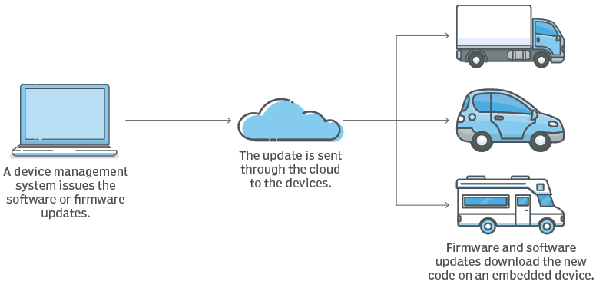
Secure Over-the-Air (OTA) Updates
Original equipment manufacturers (OEMs) can deliver OTA updates to users in a few ways.
From the end user's perspective, the OTA update can either be automatic or manual.

Slide 31
Secure Over-the-Air (OTA) Updates
With an automatic OTA update, the back-end system of a mobile operator can push a firmware update to the end user's device.
OEMs can use products that automate OTA updates, such as platforms from Smith Micro and Akamai, to manage and deploy OTA updates to their end users' devices.
Devices that are in remote locations, such as IoT sensors, or devices that don't have frequent human contact, such as an autonomous vehicle, are good contenders for automatic OTA updates.

Slide 32
Secure Over-the-Air (OTA) Updates
Manual OTA updates notify a user about an available update, and the user can accept or refuse to download the update on their device.
Mobile carriers can also send an SMS message to all users who have a particular device, prompting them to dial a number to receive a software update when it is most convenient.
For example, Verizon Wireless subscribers can dial *228 to either configure a 3G mobile device or update the preferred roaming list on the device.

Slide 33
Secure Over-the-Air (OTA) Updates
IoT devices can receive OTA updates in a variety of ways.
With edge-to-cloud OTA updates, a microcontroller receives firmware images from a remote server to update the underlying hardware or application.
Gateway-to-cloud OTA updates use an internet-connected gateway that receives updates from a remote server to update the software app itself, the software app's host environment or the gateway's firmware.

Slide 34
!!THANK YOU!! !! Have a Nice Day!!
Today we learned about
Network Slice Isolation
Virtualized Infrastructure Security
Network Function Verification
Secure Over-the-Air (OTA) Updates

